Slide 1
Air Quality assembly!
Notes:
Who can guess what we’re talking about today?

Slide 2
TAKE A DEEP BREATH….
WE ALL TAKE APPROXIMATELY 20,000 BREATHS EVERY DAY.
Notes:
Children guess how many breaths they take in a day

Slide 3
What is air pollution?
Notes:
Take answers

Slide 4
Air pollution is gas, dust, fumes (smoke) and smells that are harmful to people, animals and plants.
Notes:
If we looked in a dictionary, it might say…
Explain: NO2, gas which comes from burning fossil fuels (ask for suggestions of what these are), which irritates lungs, and particulates (very small bits of dust, soot, which get into our lungs)

Slide 5
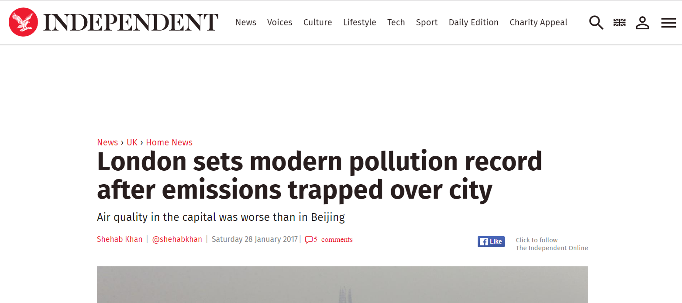
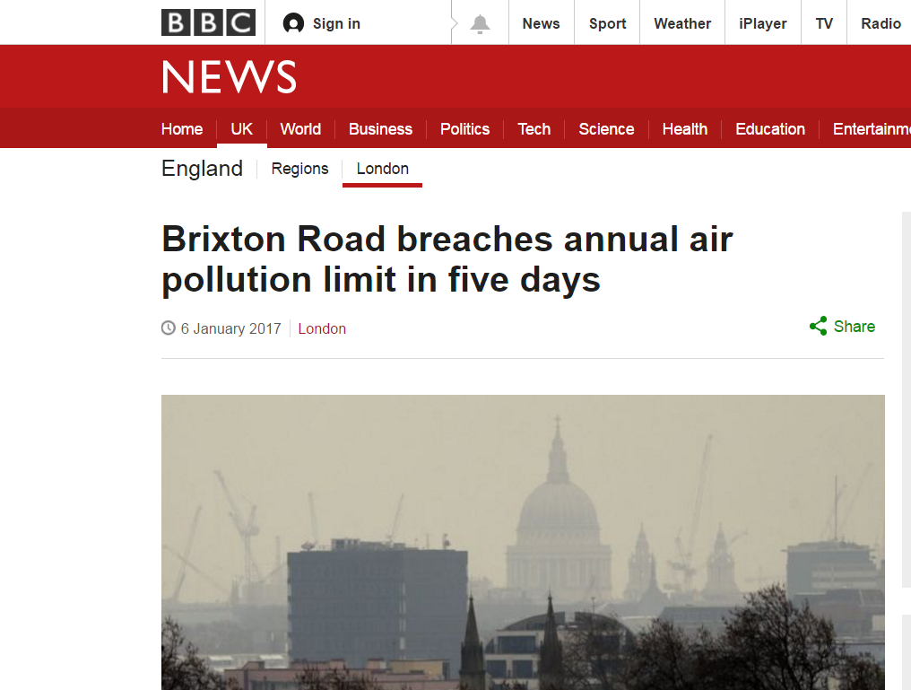
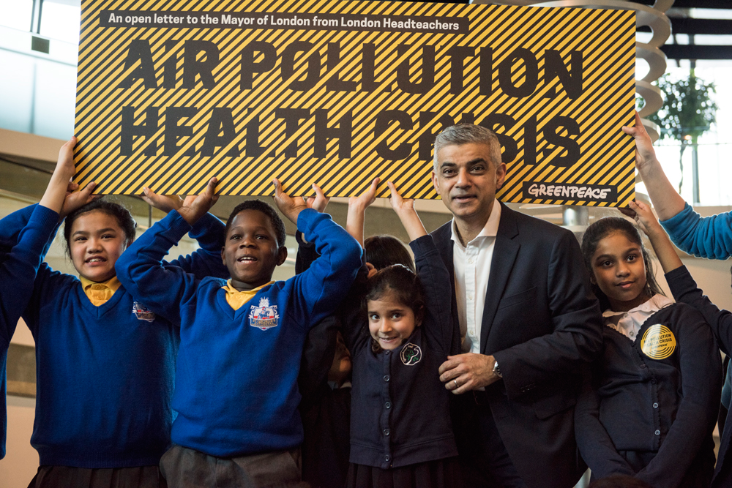
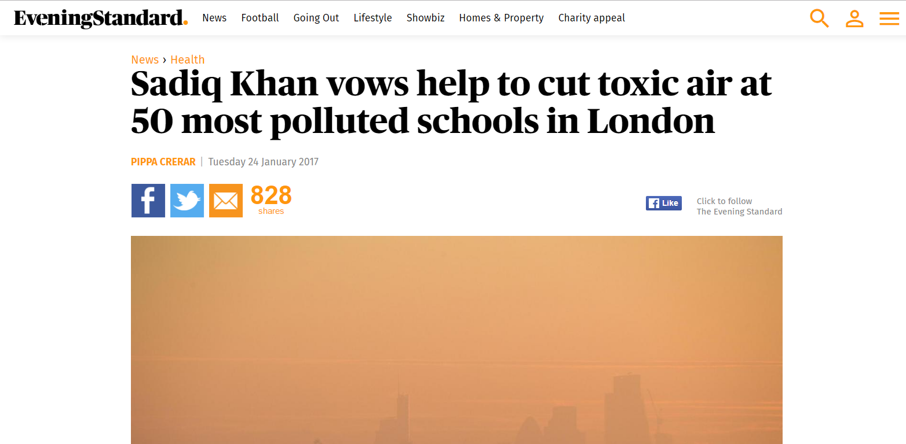
It’s big news!
Notes:
Air pollution is in the news right now! Ask who is in the picture, ask if they’ve heard about air pollution in the news/radio/tv (ask what, if time)

Slide 6
Where does air pollution come from?
Notes:
Explain there are three main sources in London, see if they can guess. Take answers and prompt with driving action/ ask what they do when cold in winter/ ask to think about all the building going on in London at the moment.

Slide 7
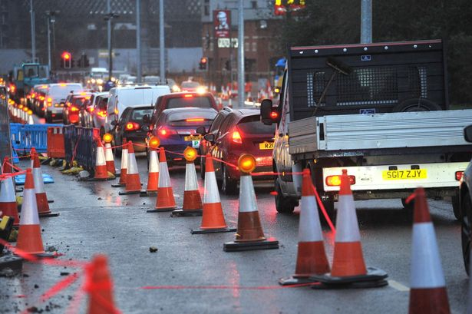
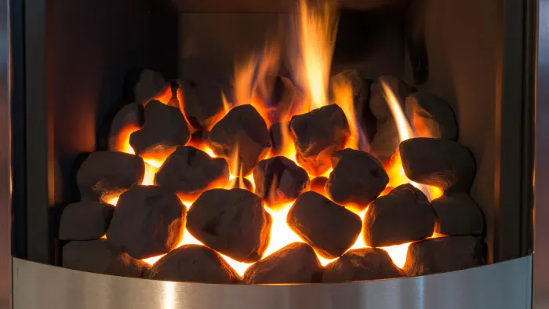
In London, most air pollution comes from:
Traffic
Construction
Heating
Notes:
The main cause of air pollution in London is traffic, followed by heating our homes, buildings and offices, and construction/ industry.

Slide 8
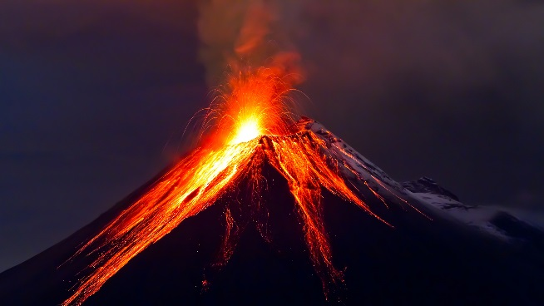
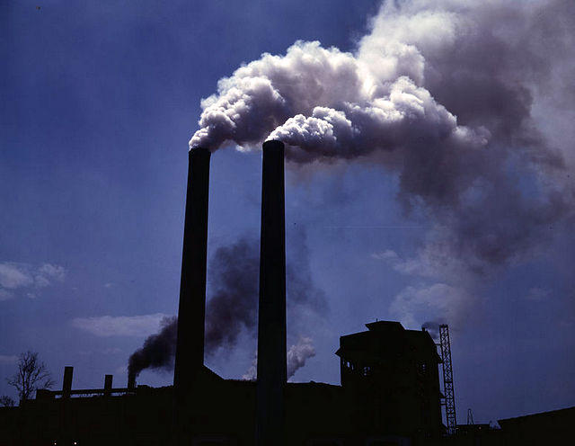
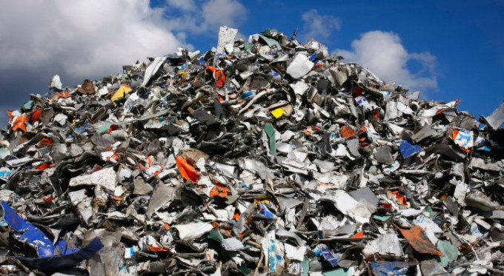
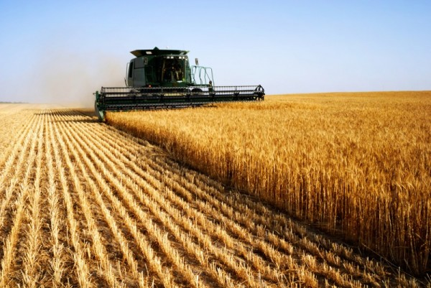
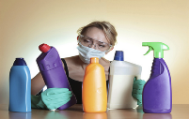
But it can also come from…
Notes:
Air pollution can also be caused by these things! Natural causes – volcanos cause smoke; factories & power plants burning fuel; all the rubbish we create; fireworks (ask who saw fireworks in Nov); agriculture – chemicals we use.

Slide 9
Why is air pollution bad for us?
Notes:
Ask why it’s bad. Do we need to worry about it, or is it ok? Which bit of our bodies might it be bad for? What do we use to breathe in here (point to chest)? And what keeps our blood moving around our bodies?

Slide 10
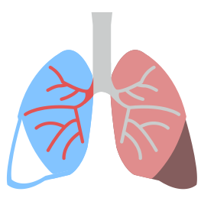
Asthma
Damages our lungs
Contributes to heart disease
Especially bad for children!

Slide 11
What can we do?
Notes:
So we’ve learnt that air pollution mainly comes from traffic. What do you think we can do about it? (ask until someone mentions cycling and walking). Ask how many walked to school today (hands up). Get them to give a clap for already doing something to help make our air cleaner.

Slide 12
Reduce: Cycle, walk, scoot!
Turn off your engine if you’re stopped
Use less energy
Re-ROUTE: Walk or wheel on quiet roads
Ask to make our streets safer to walk and cycle
And plant more trees and flowers!
Talk: Tell people about it!
Notes:
- other ideas could be: electric cars, car-sharing, driverless cars/ car club schemes

Slide 13
The Sparrow and the very smoggy city

Slide 14
Quiz time!
Notes:
We can’t really see it but air is all around us, all the time. We take our first breath when we are born and then oxygen fuels us to live exciting and fulfilling lives.
Air is making life on earth possible and ideally we’d all like to breathe unpolluted air. Sadly, this is not always the case and you’ve probably already heard about air pollution.

Slide 15
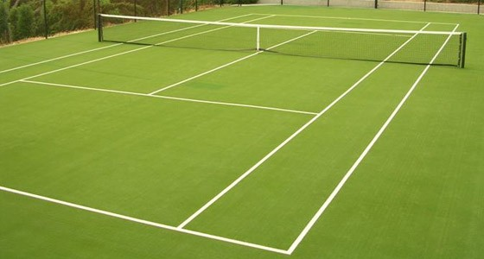
What is the total surface area of your lungs?
a) The size of a car parking space
b) The size of a tennis court
c) The size of a swimming pool

Slide 16
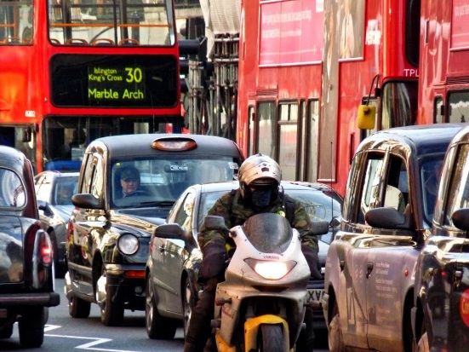
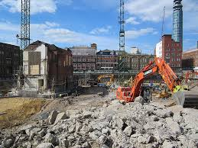
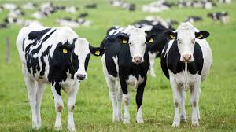
What is the main cause of air pollution in London?
a) Traffic
b) Building sites
c) Cows

Slide 17
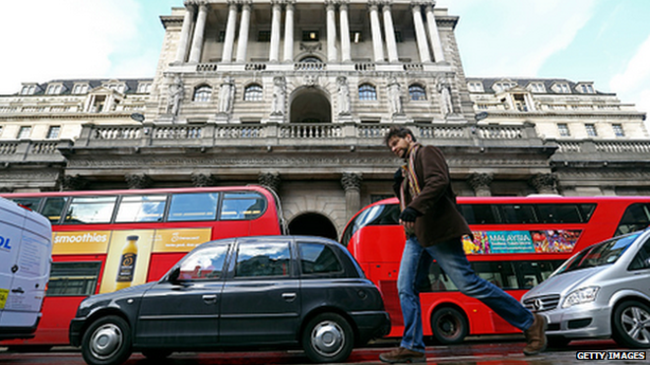
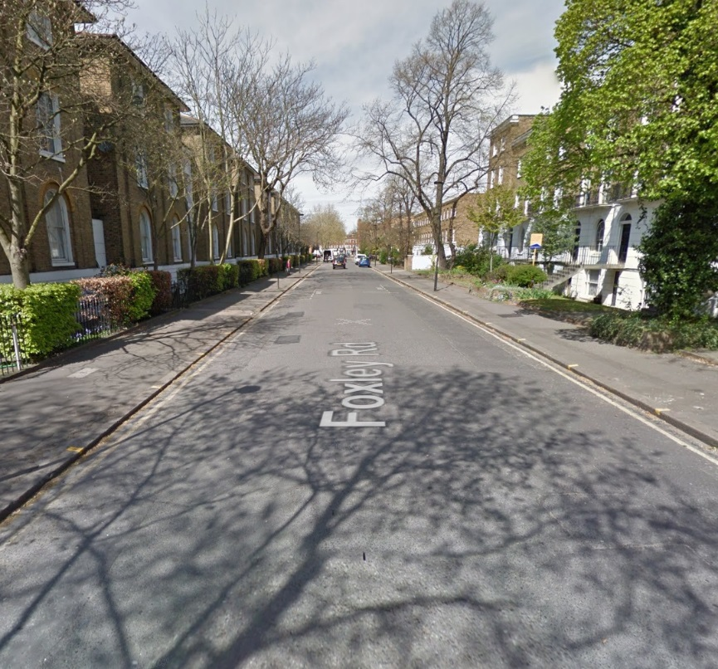
Which of these roads is best to walk along to avoid air pollution?
a)
b)

Slide 18
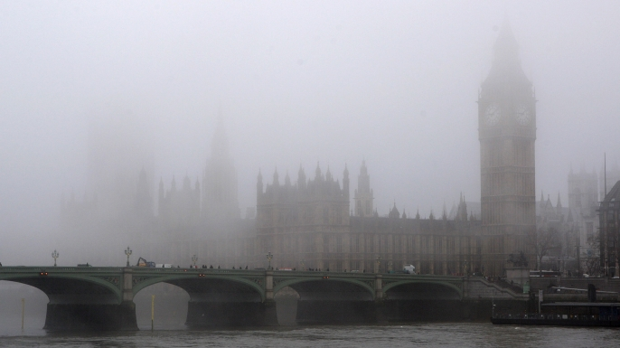
True or false ?
TRUE!!
In 1952 in London air pollution was so bad people couldn’t see their own feet!

Slide 19
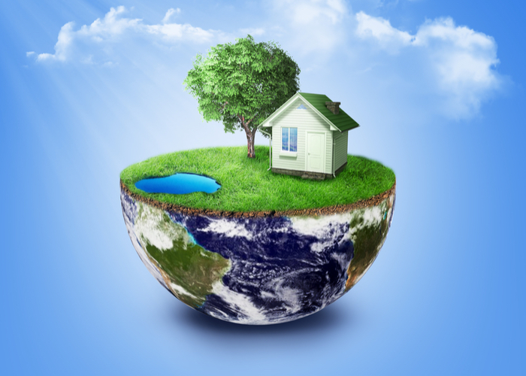
Which of these is NOT something we can do to reduce air pollution?
Walk and cycle
b) Drive everywhere
c) Use less energy
d) Turn your engine off if you’re waiting in a car

Slide 20
Let’s work together to make the air cleaner around our school!
Notes:
Reminder….

Slide 21
Winter competition!
Design a banner for the outside of your school that informs and inspires people about how to improve air quality…..
Notes:
Reminder….

Slide 22
Some ideas for your banner…
Travelling to school actively
(scooting, cycling, walking, Skating, wheeling and more!)
making streets nicer for people to walk and cycle
planting trees and flowers!
…

Slide 23
Some ideas for your banner…
Using the car less
Turning engines off outside school
Travelling with friends
…BE CREATIVE!

Slide 24
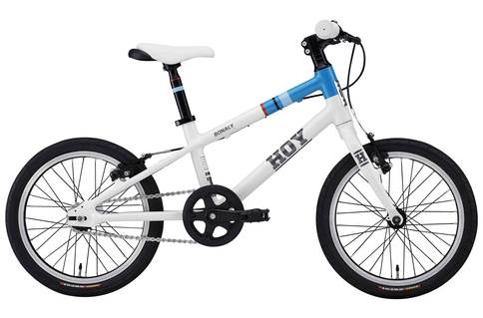
PRIZES!
The winning design from each borough will be made in to a real banner and put up outside your school!
The person who creates the best design in London will get a brand new bike for their school!
The winner from each school will receive a certificate

Slide 25
The last day to enter is Friday14th February

Slide 26
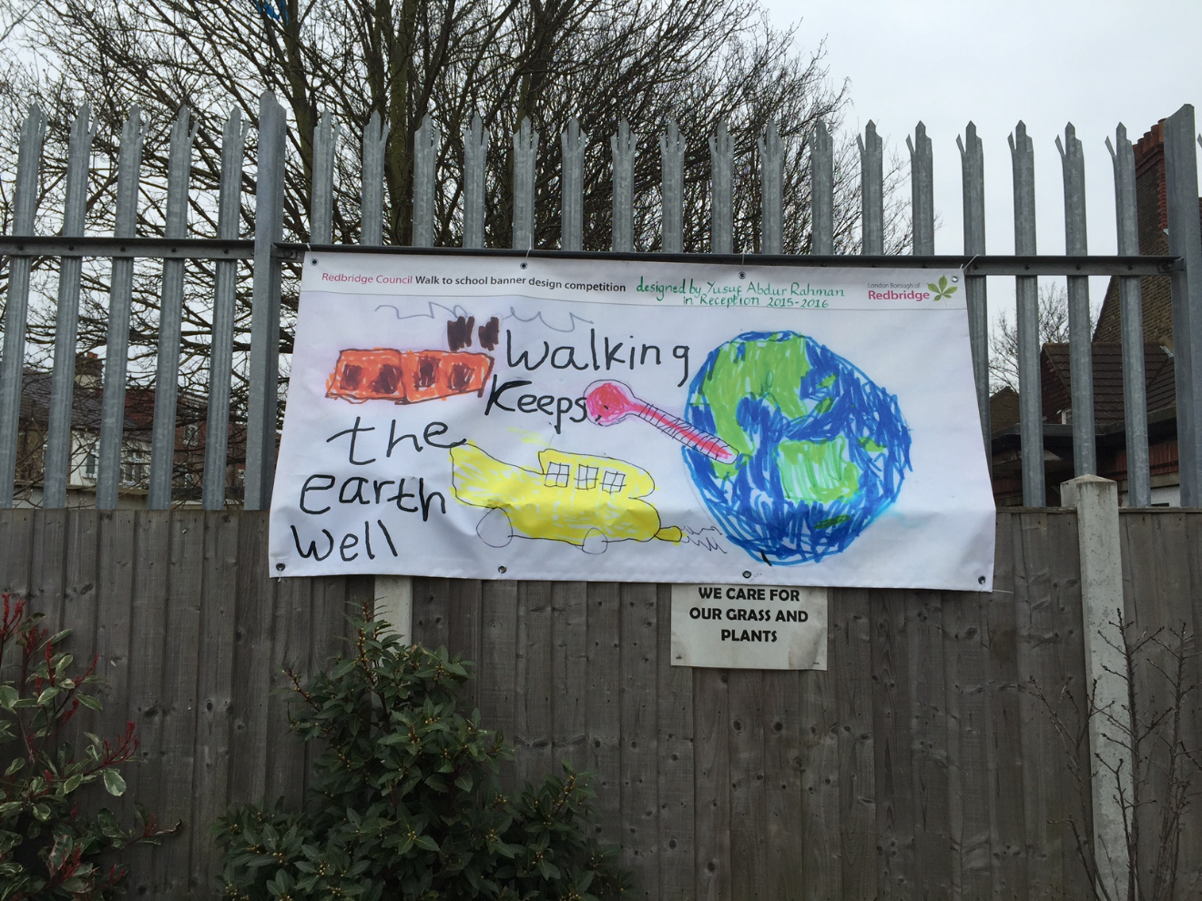
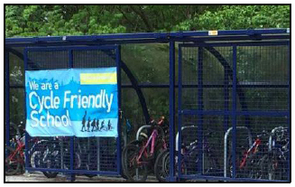
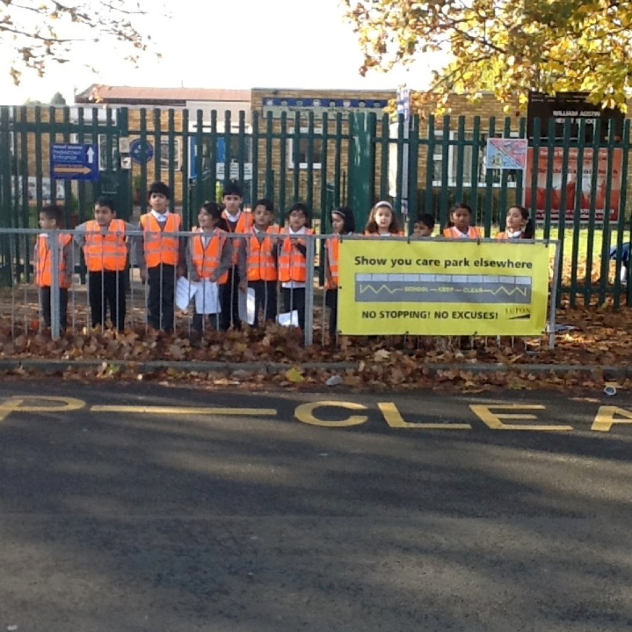
Your design could be here!

